Slide 1

Realistic Images Generation
Scientific Computing Department
Faculty Of Computer & Information Science
Ain Shams University

Slide 2
Under Supervision
Dr. Manal Mohsen Tantawi
TA. Radwa Reda Hossieny
Team members
Ahmed Shaaban Abdo Hassan
Ammar Yasser Mahmoud Saad
Ehab Mohamed Abd Elmonem Mohamed
MennatAllah Wael Saed Abd Elwahab
Mohamed Hesham Eldesouky Mohamed
Nada Mohamed Taalab Abdullah

Slide 3
Table of content
01
05
02
06
03
07
Problem Definition
System Architecture
Motivation
Tools
Objective
Time Plan
04
Survey

Slide 4
01
Problem Definition

Slide 5
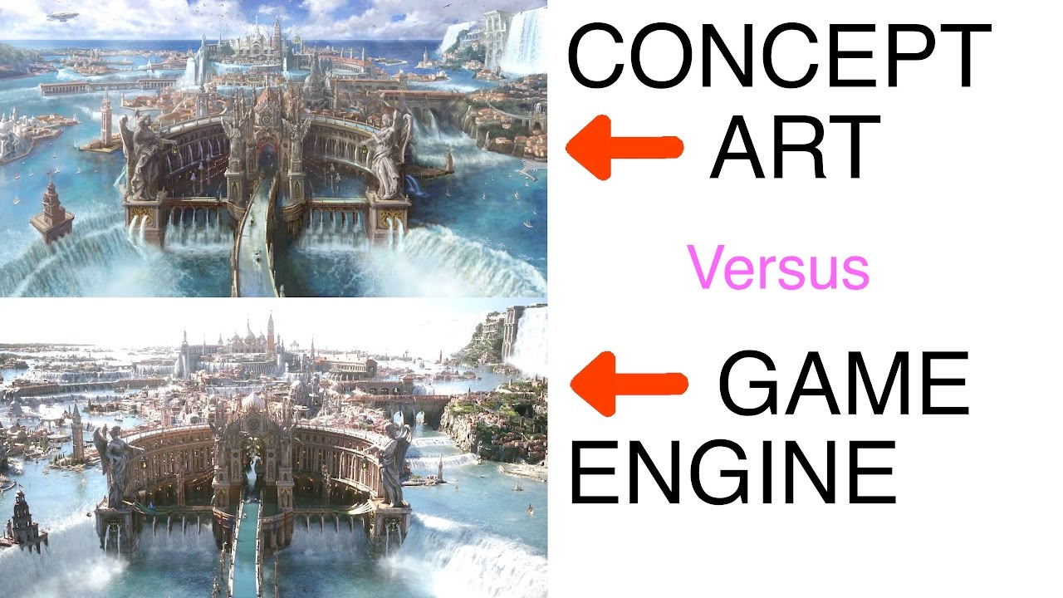
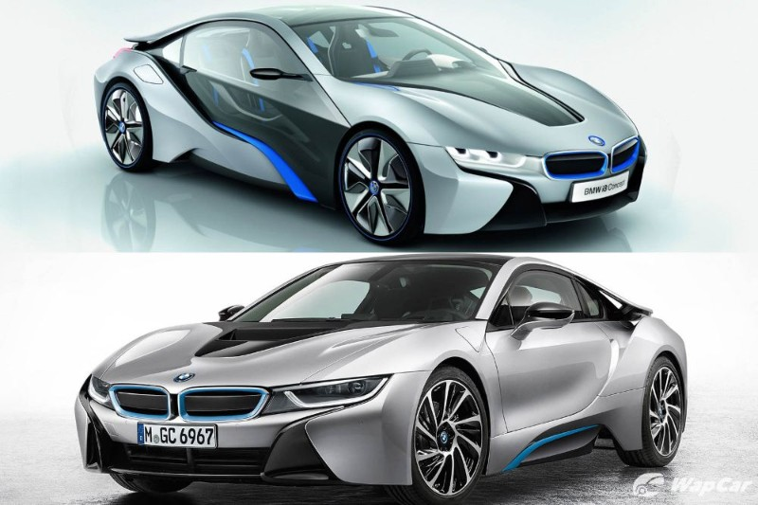
Problem Definition
Designing an object or a product has always been a time and resources consuming task, it can take from weeks to months to design a concept which is too challenging in our rapidly growing world
Getting rid of the concept designing process will not help as this will lead to developing a product that won’t satisfy the requirements which is the main focus in developing product

Slide 6
02
Motivation

Slide 7
Motivation
Saving time and effort taken by designers to design a concept art, for industry, saving cost of products and speeding up the production process
According to TrueList, the rate of increase in designing field is expected to grow by 3% by the year 2030
Recently, new technologies are developed, but there are not much researches made for them and no clear approvals, that can be used to solve such a problem

Slide 8
03
Objective

Slide 9
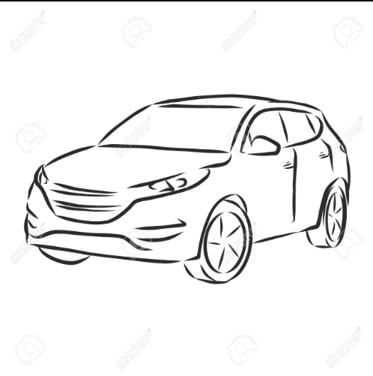
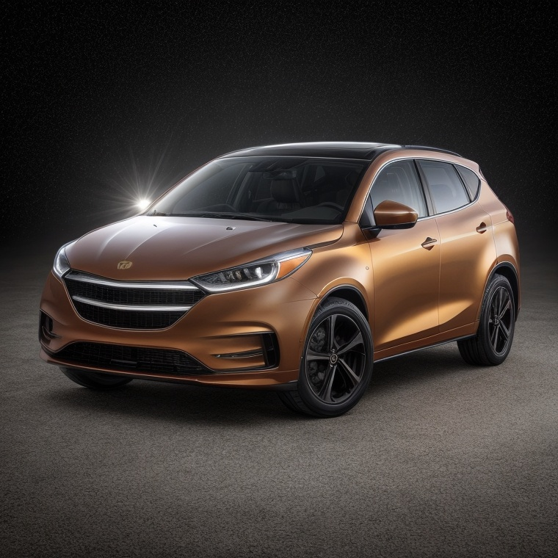
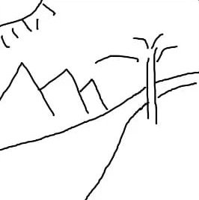

Objective
Our goal is to develop a system that generates images from hand sketches using deep learning to make the process of concepts designing faster and less cost

Slide 10
04
Survey

Slide 11
Survey
Author | Dataset | Preprocessing | Model | Evaluation
Chengying Gao et al. [1] [2020] | SketchyCOCO | Edge Detection | EdgeGAN | FID: 87.6
Xiaoyu Xiang et al. [2] [2021] | Scribble QMUL-Sketch SketchyCOCO | - | AODA | FID: 114.8
Chengying Gao [3] [2020] | Sketchy-COCO | Sketch Segmentation Edge extraction Attribute vector Generation Resized | Edge GAN | FID = 80.3

Slide 12
Survey cont.
Author | Dataset | Preprocessing | Model | Evaluation
Runtao Liu [4] [2020] | ShoeV2 ChairV2 | Resized | 2-stage model | FID = 48.73
Subhadeep Koley et al. [5] [2023] | ShoeV2 Handbags ChairV2 | Colorization Inpainting Enhancements Style-transfer Simple Arithmetic Operations | StyleGAN | FID=35.85 FID=100.23 FID=90.21
Ankan Kumar Bhunia et al. [6] [2022] | Creative Birds Creative creatures | Resizing Normalization | Doodler Former | FID =16.45 FID =18.71
Yunji Kim et al. [7] [2023] | MS-COCO | - | Dense Diffusion | SOAI: 77.61

Slide 13
Survey cont.
Author | Dataset | Preprocessing | Model | Evaluation
Changqing Zou et al. [8] [2018] | QuickDraw TU-Berlin | semantic Instance segmentation | DeepLab-v3 | OV Acc=88.38
Li Liu et al. [9] [2017] | TU-Berlin Sketchy | - | DSH | MAP: 0.57 MAP: 0.783
Sheng-Yu Wang et al. [10] [2021] | LSUN QuickDraw | - | Photosketch | FID: 19.94

Slide 14
Survey cont.
Author | Dataset | Preprocessing | Model | Evaluation
Wenjing Huang et al. [11] [2023] | COCO-Animals | Augmentation Sampling Encoding Adding Noise | PFB | FID: 6.259
Ahmed Ramy [12] [2022] | Edges2shoes Edges2 Handbags | Resizing Converting to arrays Normalization | Conditional GAN | FID =96.514 FID =130.325
Yongyi Lu [13] [2018] | CelebA CUB-200 Stanford's Cars | XDoG Photocopy simplified | Contextual GAN | Accuracy = 99.8

Slide 15
Survey cont.
Author | Dataset | Preprocessing | Model | Evaluation
Wengling Chen et al. [14] [2018] | ImageNet COCO | Filter Normalization Resize | SketchyGAN | Inception Score = 7.91
Wengling Chen et al. [15] [2018] |  | Normalization Resizing | MRU | Insception Score=7.90

Slide 16
Comments on survey
The most common architectures for this task are GANs.
GANs are much limited to specific domains which gives advantage to Diffusion Models.
Diffusion Models are more generalized which makes them suitable for non-domain-specific problems.
Fréchet inception distance (FID score) score is the common measurement.
Normalization and Resizing are necessary preprocessing steps.

Slide 17
05
System Architecture

Slide 18
System Architecture
Generative Model
1
2
3
Preprocessing
Output

Slide 19
Common Datasets
Name | COCO | QuickDraw | TU-Berlin
Size | 328K images | 50M sketches | 20K sketches for 100K+ images
Categories | 80 categories | 345 categories | 250 categories
Comments | sketches are not provided , instead they’re gathered from edge detection on original images | single object sketches labeled with their names | it’s a relatively small size dataset with a single object in the scene which makes it an ideal start

Slide 20
Selected Dataset
(TU-Berlin)
Users were asked to sketch objects they see in the corresponding images.
All sketches in the dataset are drawn by humans, which makes it a great resource for studying human sketching behavior.

Slide 21
Preprocessing
It is not mentioned as a step when using our selected dataset, so we did the following as enhancement steps:
Resized to 500 x 500
Binarization
Blurring with kernel size 13 x 13
Binarization
Dilation with kernel size 13 x 13

Slide 22
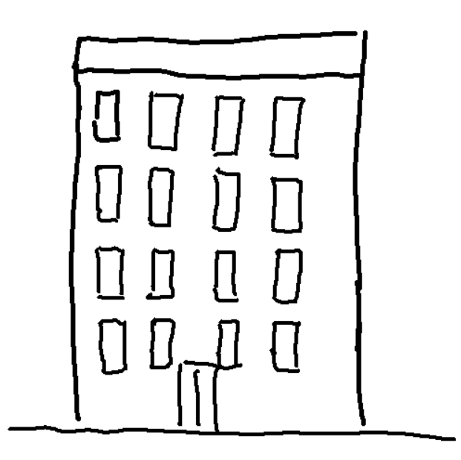
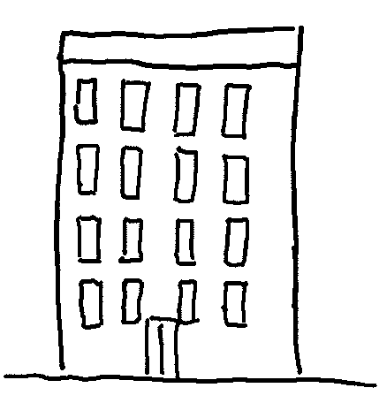


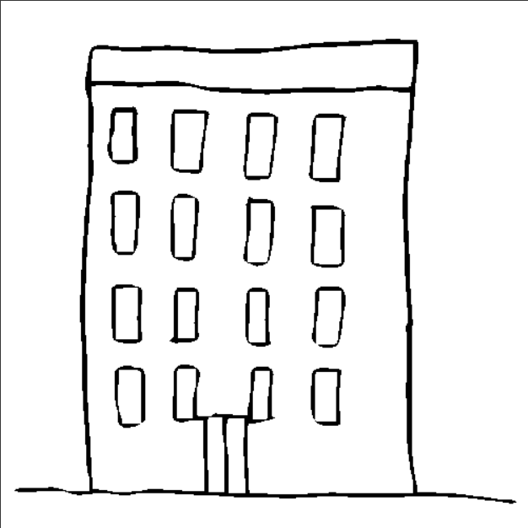
Preprocessing
Resized Image
Binarization
Blurring
Binarization
Dilation

Slide 23
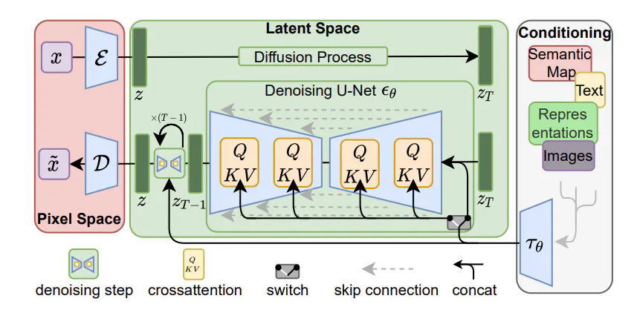
Recommended Algorithm
(Diffusion Models)
In our case, the condition is a sketch
The corresponding image is encoded using a condition encoder, denoised by a U-Net denoiser, then decoded using an image decoder.

Slide 24
06
Tools

Slide 25





Tools
Python
Colab
PyTorch
Flask
React JS, Node JS

Slide 26
07
Time Plan

Slide 27
Time Plan
Phase Name | Oct 2023 | Nov 2023 | Dec 2024 | Jan 2024 | Feb 2024 | Mar 2024 | Apr 2024 | May 2024 | Jun 2024
Survey about related work
Dataset Selection
Project Design and Architecture
Implementation
Testing and Integration
Deployment
Demo Release
Documentation

Slide 28
08
References

Slide 29
References
Chengying Gao, Qi Liu, Qi Xu, Limin Wang, Jianzhuang Liu, Changqing Zou (2022) SketchyCOCO: Image Generation from Freehand Scene Sketches
Xiaoyu Xiang, Ding Liu, Xiao Yang, Yiheng Zhu, Xiaohui Shen, Jan P. Allebach (2021) Adversarial Open Domain Adaptation for Sketch-to-Photo Synthesis
Chengying Gao, Qu Liu, Limin Wang, Jianzhuang Liu, and Changqing Zou (7.4.2020) SketchyCOCO: Image Generation from Freehand Scene Sketches
Runtao Liu, Qian Yu, and Stella Yu (23.3.2020) Unsupervised Sketch-to-Photo Synthesis
Picture that Sketch: Photorealistic Image Generation from Abstract Sketches
Li Liu et al.(2017), Deep Sketch Hashing
Yunji Kim, Jiyoung Lee, Jin-Hwa Kim, Jung-Woo Ha, Jun-Yan Zhu (2023) Dense Text-to-Image Generation with Attention Modulation

Slide 30
References
SketchyScene: Richly-Annotated Scene Sketches
Sheng-Yu Wang, David Bau, Jun-Yan Zhu (2021) Sketch Your Own GAN
Wenjing Huang, Shikui Tu, Lei Xu, Shanghai Jiao, Tong University (2023) PFB-Diff: Progressive Feature Blending Diffusion for Text-driven Image Editing
Yongyi Lu ,Shangzhe Wu,Yu-Wing Tai, (2018) , Sketch Constraint Using Contextual GAN
Hangyu Lin, Yanwei Fu , (2020) ,Sketch-BERT: Learning Sketch Bidirectional Encoder Representation
SketchyGAN: Towards Diverse and Realistic Sketch to Image Synthesis

Slide 31
Thanks!
Do you have any questions?

